Slide 1

Usage of CO₂ in the Balmatt Case
Meeting 27/11/2023
Pietro Ungar
Researcher
SERG Group

Slide 2
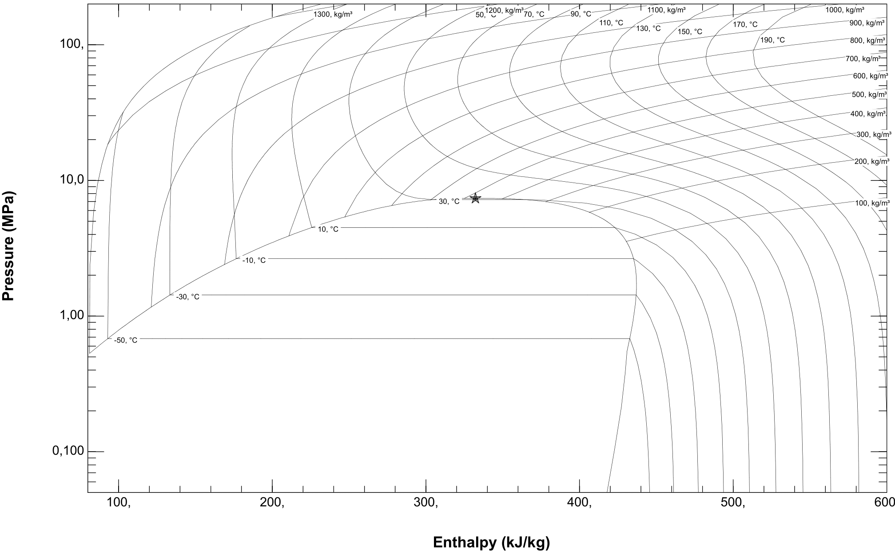
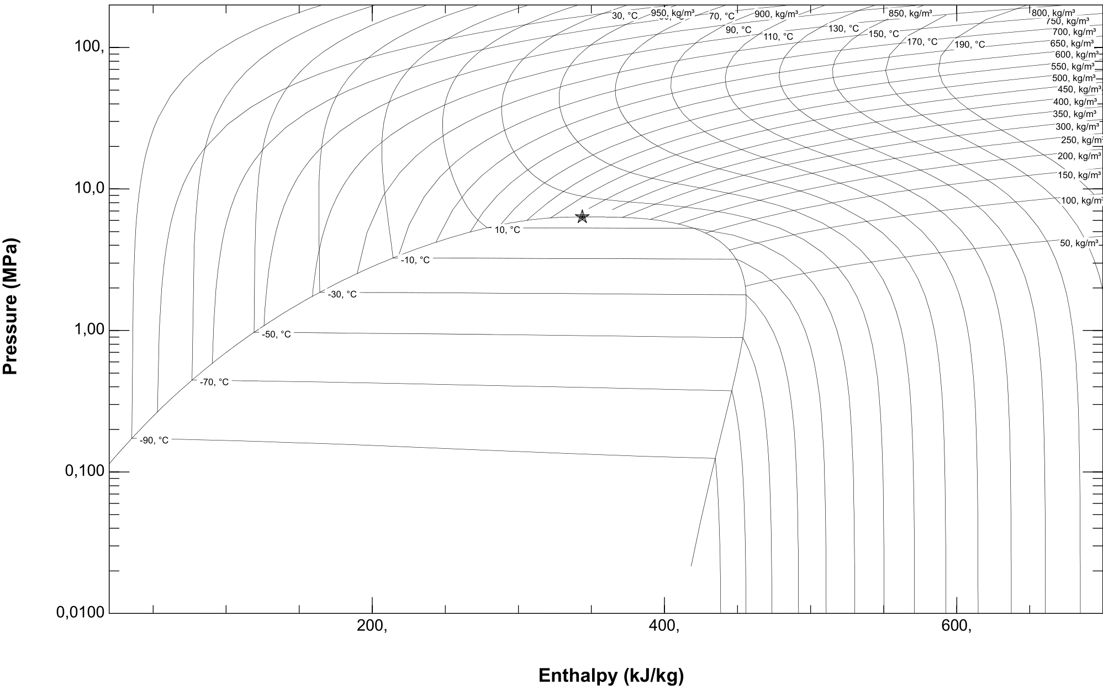
1
CO₂ Mixtures
Pure CO₂
75% CO₂ – 25% Ethylene
Conditions: Vertical Well, 500m deep,
7 inch casing. Geology from Balmatt,
No fluid flow in the reservoir

Slide 3
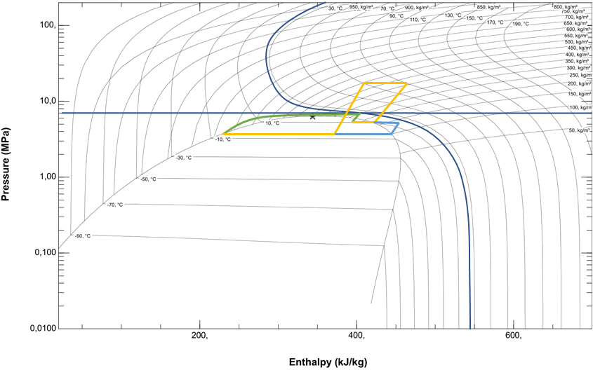
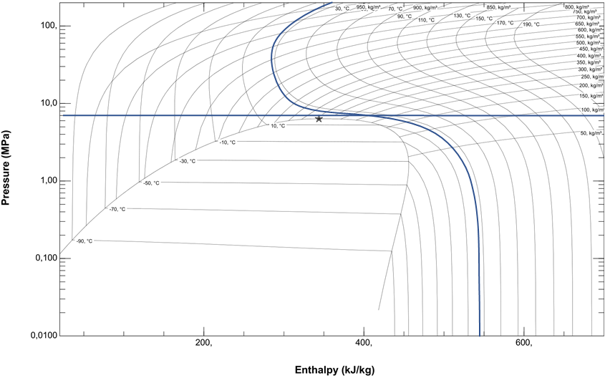
2
Possible Heat Pump
COP: 3
Q: 250 [kW]
W: 80 [kW]
m_{well}: 1 [kg/s]
Q_{well}: 170 [kW]
7
6
7
6
8
3
4
5
2
5
4
1
8
3
2
1
Conditions: Vertical Well, 500m deep,
7 inch casing. Geology from Balmatt,
No fluid flow in the reservoir

Slide 4
3
Possible CHP Application
7
6
2
5
4
1
8
3
Conditions: Vertical Well, 2000m deep,
7 inch casing. Geology from Balmatt,
No fluid flow in the reservoir

Slide 5

3
Conclusions
With Mixture:
Feasible even for shallow depths
Reasonable COP for a demonstrator (to be optimized)
Problems with mixtures to be addressed:
Compessor: To be engineered carefully (scroll compressor usually used for this kind of mixtures)
Possible compatibility issue with polymers
Depending on the concentration can be flammable
Expander problem:
Currently does not exist (to my knowledge)

